Slide 1


TIME MACHINE EXERCISE
We’re going to unlock your imagination with this simple question “WHAT WOULD I LOVE?” Imagine you are in a time machine and it’s 3 years from today and everything you would love has already worked out. The question is, WHAT WOULD YOU LOVE TO SEE, TO BE, TO HAVE in your VOCATION at Blue Valley School? You have 2 minutes to write down this amazing vision. Write this at the top of your paper: “I am so happy and grateful now that ….” insert your vision statement here. Avoid using the condition-based words: HOW/BECAUSE/WHY/SO THAT. Write using vision-based language: present tense, positive words, use feeling tones, be specific.
theROFactor.com

Slide 2
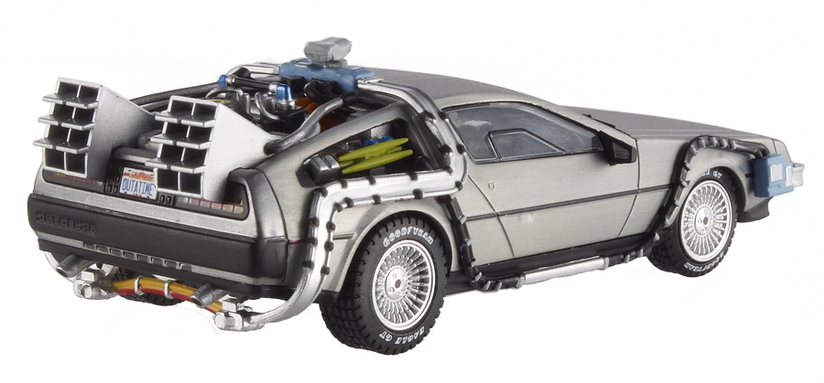
Time Machine → 3 Years
What would I LOVE?
theROFactor.com
Notes:
We’re going to unlock your imagination with this simple question “WHAT WOULD I LOVE?” Imagine you are in a time machine and it’s 3 years from today and everything you would love has already worked out. The question is, WHAT WOULD YOU LOVE TO SEE, TO BE, TO HAVE in your VOCATION at Blue Valley School? You have 2 minutes to write down this amazing vision. Write this at the top of your paper: “I am so happy and grateful now that ….” insert your vision statement here. Avoid using the condition-based words: HOW/BECAUSE/WHY/SO THAT. Write using vision-based language: present tense, positive words, use feeling tones, be specific.

Slide 3


What would you
LOVE?
I am so happy and grateful
now that…
theROFactor.com

